Slide 1
Allen Brook College of Data & Engineering (ABCDE) Placement Analysis (Academic Year 2024–2025)
- A Data Analytics Case Study by Anik Chakraborty

Slide 2
🎯 Objective
To develop an interactive Placement Analytics Dashboard to analyze placement performance and key salary drivers for Allen Brook College of Data & Engineering (ABCDE).
Project Purpose:
Evaluate placement outcomes to uncover factors—CGPA, degree background, specialization, gender, work experience—that influence placement success and salary levels.
Build an interactive Excel dashboard for college administrators, career services, and students.
Provide actionable recommendations to improve placement support and student readiness.
Key KPIs:
Overall Placement Rate, Average & Median Salary, Placement Rate by Gender/Background, Average Salary by CGPA Band, Top-paying Specializations.
Deliverables:
Excel dashboard, presentation slides, and a concise insights report.

Slide 3
📘 Project Overview
Context Highlights:
Analyzed placement records of 215 students from Allen Brook College of Data & Engineering (ABCDE).
Dataset covers academic metrics (degree type, specialization, CGPA), demographics (gender, work experience), and placement outcomes (status, salary).
Demonstrates how data analytics empowers institutional decisions to optimize placement strategies and student performance evaluation.
Built an interactive Placement Analytics Dashboard using Excel (Pivot Tables, Charts, and KPI visuals). Key insights derived on:
Overall placement rate and salary distribution
CGPA-to-salary correlation patterns
Gender and background-based placement trends
Specialization-wise salary contributions

Slide 4
🗂️ Data Overview & Schema
Data Source:
Source: Fictionalized college placement dataset (inspired by open educational datasets).
Data Type: Structured student records and outcomes (placement status and salary).
Time Period: One-time snapshot for the academic year 2024-25.
Data Structure & Metrics
Key Index Types: Student-level records. Total Rows: 215.
Categories: Approximately 15 features covering three main buckets:
Demographics: Gender, Work Experience (Yes/No).
Academics: Secondary percentage (ssc_p), Higher Secondary percentage (hsc_p) & background (hsc_b), Degree percentage (degree_p) & degree type (degree_t) and MBA percentage (mba_p) - Backgrounds/Types Specialization – Mkt&Fin / Mkt&HR
Placement: Placement Status and Salary.
Calculated Metrics: Binary Placement Status (placement_flag = 1/0) derived for classification modeling.

Slide 5
💻 Tech Stack
Tools
Microsoft Excel
Data cleaning & preprocessing
Pivot Tables for aggregation
Pivot Charts for visualizations
Slicers/filters for interactivity
Dashboard creation
PowerPoint
Presentation and final dashboard snapshots

Slide 6
📈 Methodology & Analysis
Prepare, Process & Analytical Approach:
• Removed missing or inconsistent values to ensure clean and reliable data.
• Standardized categorical fields such as Degree Type and Specialization for uniformity.
• Grouped CGPA into defined ranges (e.g., 5.00–5.99, 6.00–6.99) for better aggregation.
• Created derived fields like placement_flag (1 = Placed, 0 = Not Placed) to support KPI analysis.
• Descriptive Analytics: Measured overall placement rate and examined distributions by gender, specialization, and degree type.
• KPI Analysis: Calculated % of students placed, average salary, and salary extremes (highest & lowest).
• Correlation Analysis: Explored the relationship between CGPA and salary, and between placement status and CGPA.
• Pivot Tables – for summarizing placement and academic metrics.
• Pivot Charts – to visualize trends and comparisons.
• Slicers & Filters – to add interactivity for dynamic analysis.

Slide 7
❓ Problem Statement
Colleges often collect placement data, but it remains scattered and underutilized.
Key challenges:
No consolidated view of placement performance.
Difficulty in tracking placement rate, salary distribution, and CGPA trends.
Limited ability to compare outcomes across gender, specialization, and academic background.
Without clear insights, colleges struggle to:
Identify areas where students need support.
Provide data-driven guidance to future batches.
Showcase placement performance to recruiters and stakeholders.

Slide 8
💡 Key Insights
Placement Rate: 69% (148 out of 215 students)
Gender Gap: Male avg salary (215K) > Female avg salary (169K)
Academic Background: Sci&Tech students have the highest avg salary (~219K)
Specialization: Mkt&Fin students earn 57% more than Mkt&HR students
CGPA Correlation: Salary rises with CGPA (8–9 CGPA avg = 345K)

Slide 9
📊 Dashboard Overview
Built Using:
Microsoft Excel with integrated Pivot Tables and Pivot Charts
Slicers and filters for interactive exploration
Clean, intuitive layout designed for easy interpretation
Key Features:
KPI Cards: Placement Rate (%), Average Salary, Highest & Lowest Salary
Placement Distribution: By Gender, Specialization, and Academic Background
CGPA vs Salary Analysis: Visual insights into performance–reward correlation
Salary Contribution: Breakdown by specialization and degree type
Outcome: An interactive and dynamic dashboard providing a holistic view of placement performance—enabling quick comparison, pattern recognition, and data-driven decision-making.

Slide 10
📍 Conclusion
Placement outcomes vary significantly by gender, background, and specialization
Higher CGPA → Higher Salary trend is clearly visible
Comm&Mgmt has higher student count, but Sci&Tech shows stronger salary outcomes
Dashboard provides a data-driven, at-a-glance view of placement performance
Useful for colleges to improve support strategies and for students to understand salary drivers

Slide 11
✅ Business Impact & Use Cases
College Administration & Management: Leverage placement analytics to evaluate program performance, identify academic strengths and gaps, and plan strategic improvements in training and curriculum.
Training & Placement Cell: Use data-driven insights to monitor placement trends, target underperforming student groups, and strengthen industry partnerships through transparent reporting.
Faculty & Academic Departments: Understand how academic background and specialization influence placement outcomes, guiding curriculum updates and mentorship strategies.
Students & Career Advisors: Gain awareness of how CGPA, specialization, and skill development affect placement chances and salary expectations, helping tailor preparation plans.
Recruiters & Industry Partners: Access data-supported insights on student quality, academic diversity, and performance trends to optimize recruitment strategies and hiring pipelines.

Slide 12
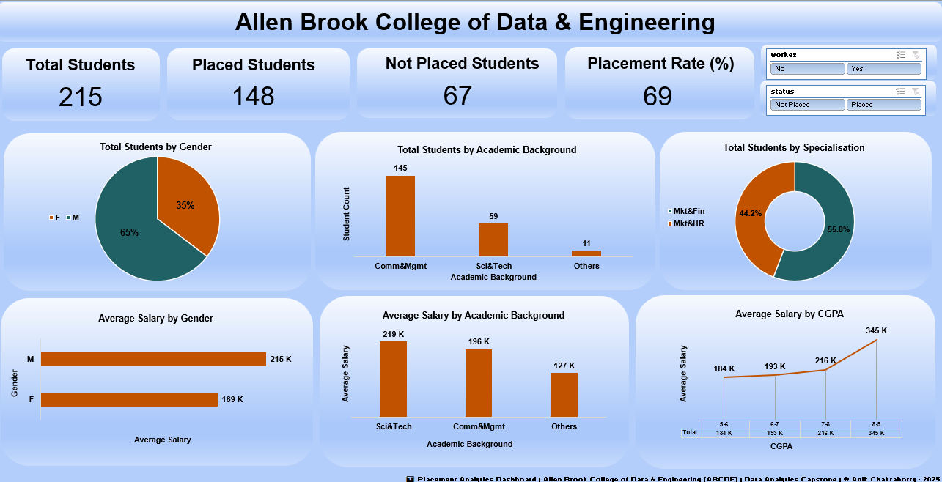
🖥️ Interactive Dashboard View

Slide 13
🙏 Acknowledgement & Contact
Project Analyst: Anik Chakraborty 📧 Email: anikc1710@gmail.com
Special Thanks To
Coding Ninjas – for project framework and guidance
Connect: 🔗 GitHub | 🔗 LinkedIn

Slide 14
Thank You!

